Slide 1

Team Foundation Server
Session 3 – Work Items

Slide 2


Agenda – Session 3 – Work Items
What is a Work Item?
Areas and Iterations
Planning work
Measuring progress
Story boarding

Slide 3
What are Work Items?
Team Foundation has work item tracking features designed to assist enterprise software development teams to manage their work and software defect tracking. In Team Foundation, a work item tracks this work, and can be one of the individual tasks required to complete a project, a bug that needs to be fixed, a customer scenario that the project needs to address, or any other piece of work in a project that needs to be tracked in a database.

Slide 4
Areas and Iterations
Areas – a categorization label you can apply to work items. Common use case is:
Functional classification, e.g., UI, Database, Architecture, Deployment
Location based: Minnesota, California, India, China
Version based: v1.0, v1.1, v1.2, v1.3 …
Iteration – which Iteration (time frame) the work item is planned to be started/completed. Iterations have an optional start and end date.
Both are hierarchical

Slide 5
Planning Work
Demo – Microsoft Project:
Create plan
Publish
Update
Refresh

Slide 6
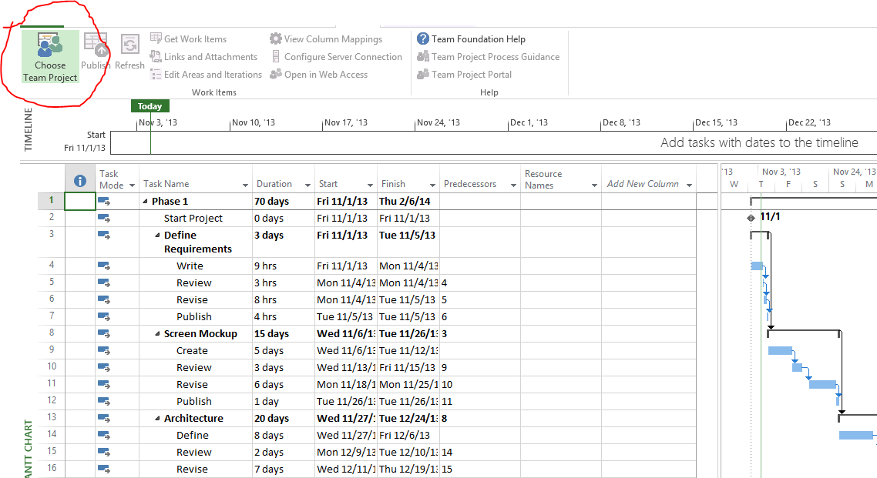
Link Project to Team Project
Have to install Project and Team Explorer
A new ‘Team’ toolbar/menu is now visible

Slide 7
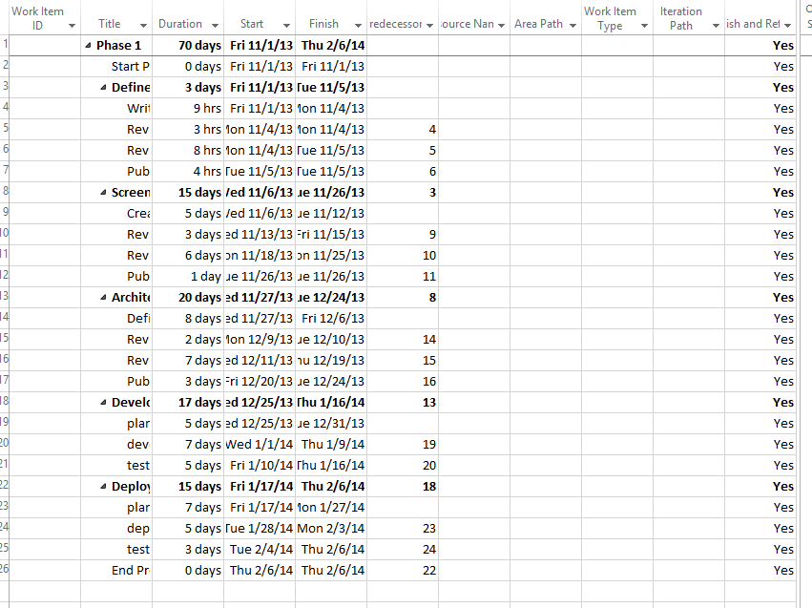
Linked
Once linked, you can set Work Item values in Project
Changes are “sync’ed” back
Can select IF the item should be sync’ed

Slide 8
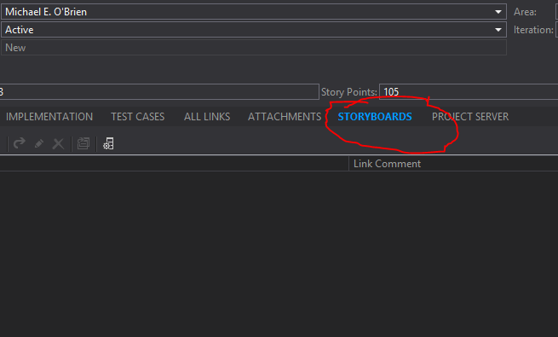
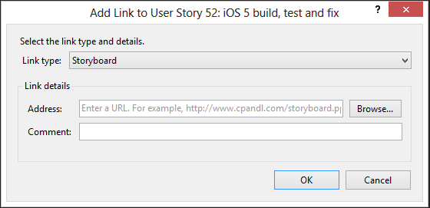
Story Boarding
Can link storyboards to a work item – as a URI
Issue – where to store storyboard files
Can add storyboards as attachment

Slide 9
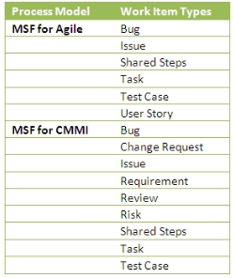
Work Item Type
Depends on the Process Template Used to create the Team Project
Work Items Types can be modified using the Process Template Editor
Process Templates can be created/modified to adapt to the desired process
Demo: Process Template Editor

Slide 10
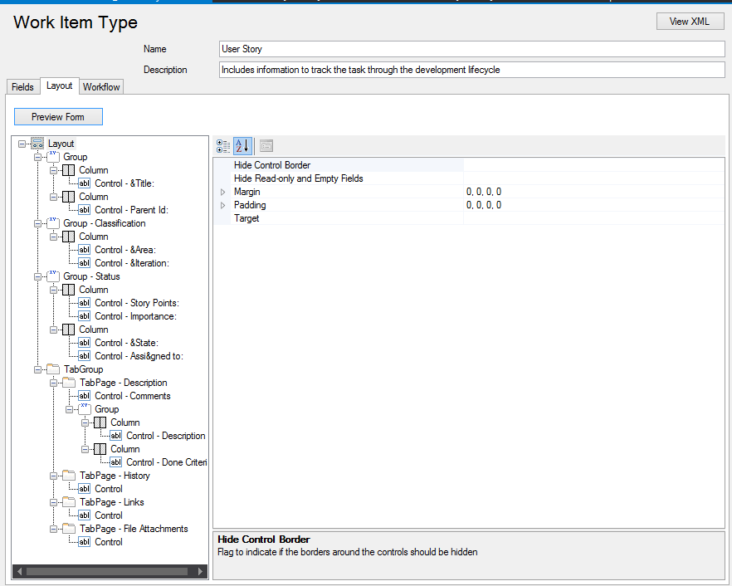
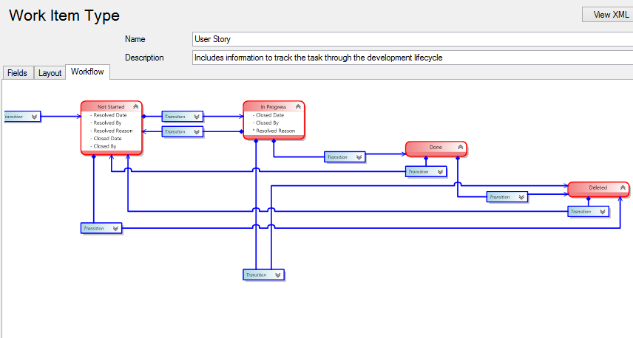
Work Item Type
A Work Item Type is a collection of properties/data and workflow
Can be edited / modified / created
Need ‘Team Foundation Server Power Tools installed – use the ‘Process Editor’

Slide 11
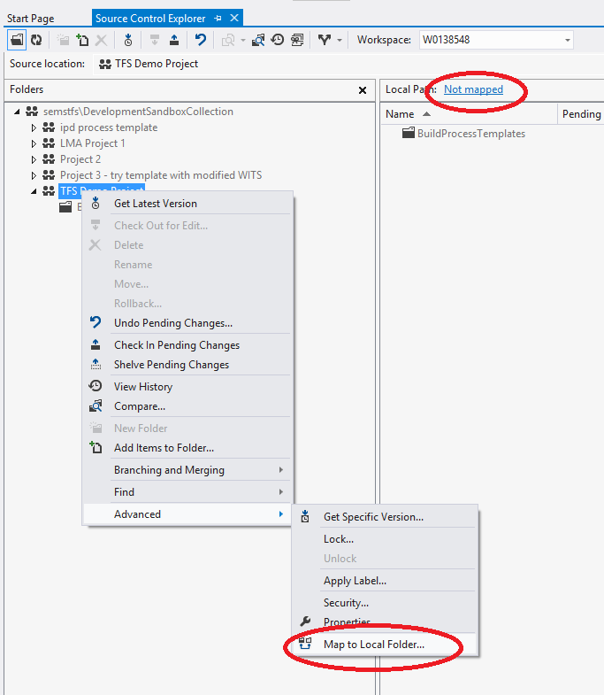
Workspaces
Map the source control folder to a local folder
Recommend mapping the top level source control folder to a short local path
$/ProjectName ➔ c:\projects\ProjectName

Slide 12
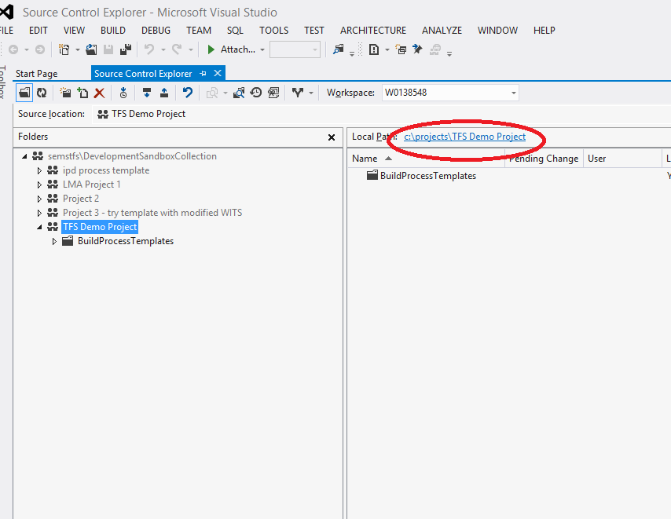
Workspaces
Map the source control folder to a local folder
Recommend mapping the top level source control folder to a short local path
$/ProjectName ➔ c:\projects\ProjectName

Slide 13
Workspaces
You can map individual folders to local folders if needed
This approach is powerful for configuration, but can be confusing for long term support
Can assign security permissions per folder – leads to confusion unless tightly managed

Slide 14
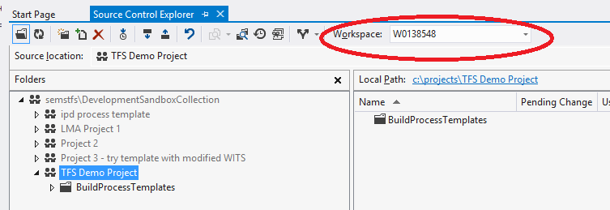
Workspaces
You can have multiple workspaces - default is your computer name
If using multiple computers, you will have multiple Workspaces – but each is computer specific. I.e., not re-usable across computers

Slide 15
Source Control – Project Structure
Promotion Model
QA
Prod
Dev

Slide 16
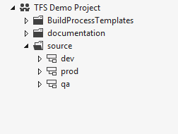
Project Structure
When setup in source control, provides a path for source code management
Demo – how to setup a new Team Project

Slide 17
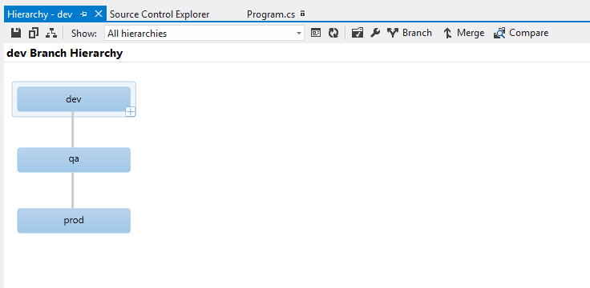
Project Structure
Tools in Visual Studio help with source code management
Enable visualization of code with tools to compare and merge
Visual Studio 2012 – new merge tool.

Slide 18
Check in & Check out
How do I get my code into TFS?
Easiest Method
create and/or copy code into working path
“add to source control”
Check in
Note: each Check-in is call a ‘Changeset’ within TFS – and assigned an Id
If you have Power Tools installed – add from Windows Explorer

Slide 19
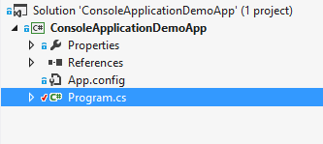
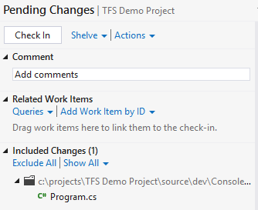
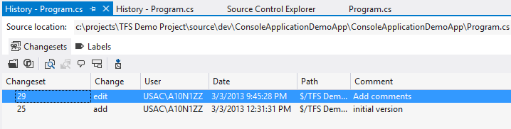
Check in & Check out
How do I get my Team’s code?
Easiest Method
Get Latest on top level folder, or on Solution
Demo: show Check in, Check out, Get Latest, Show History

Slide 20
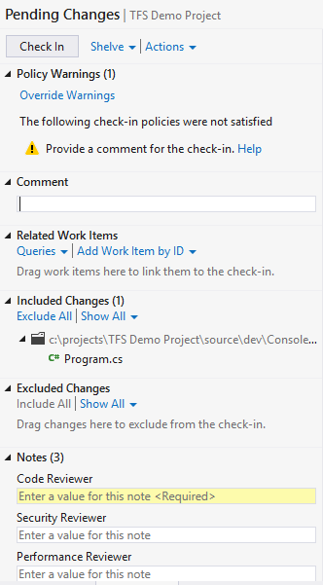
Check in & Check out
Check-in Policies - Allows the team to set norms and enforce, such as:
Check-in comments
Check-in Notes – similar – require notes at Check-in time
Demo: show Check in, Check out, Get Latest, Show History

Slide 21
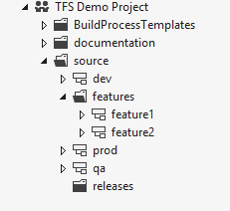
Branching / Merging
Can get complicated – keep it as simple as possible
Increased team size or <1 teams = more complicated
Merge as often as possible – keeps conflicts to minimum

Slide 22
Branching / Merging
Demo – Branching / Merging

Slide 23
Shelvesets
Shelvesets are useful when you want to stop work for:
Interruption: You have pending changes that are not ready for check in, but you need to work on a different task.
Collaboration: You have pending changes that are not ready for check in but you need to share them with another team member.
Code Review: You want another team member to perform a code review of your pending changes.
Private Build: Before you check in your changes, you can use your automated build system to build and test your code.
Backup: You have work in progress that you cannot finish now so you want a backup copy that is stored on your server and available to other team members who might need to access it.
Handoff: You have work in progress that you want to hand off to another team member.
Suspend Your Work and Manage Your Shelvesets
http://msdn.microsoft.com/en-us/library/ms181403.aspx

Slide 24
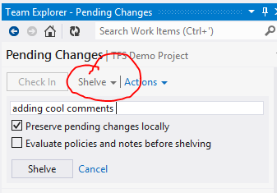
Shelvesets
Demo – Shelve a change

Slide 25
Automated Builds
Perform a build on ‘trigger’ operations, such as:
Code Check-in (Continuous Integration)
Fixed time (nightly build)
Requested (manual build)
Automated build can also run Unit Tests to ensure new code is passing automated tests
Tip: When performing an automated build, use the Workspace to only retrieve the minimum source code

Slide 26
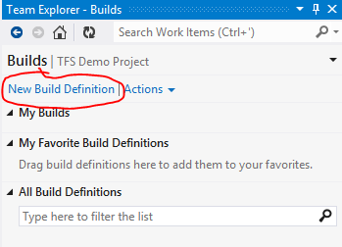
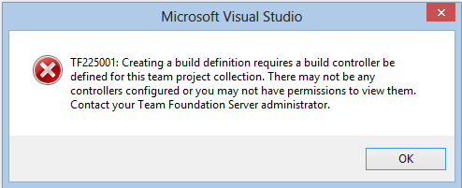
Automated Builds
Demo – define a new build
Need a build machine defined for the Project Collection

Slide 27
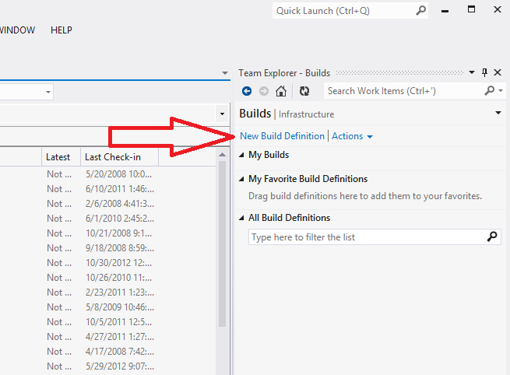
Automated Builds

Slide 28
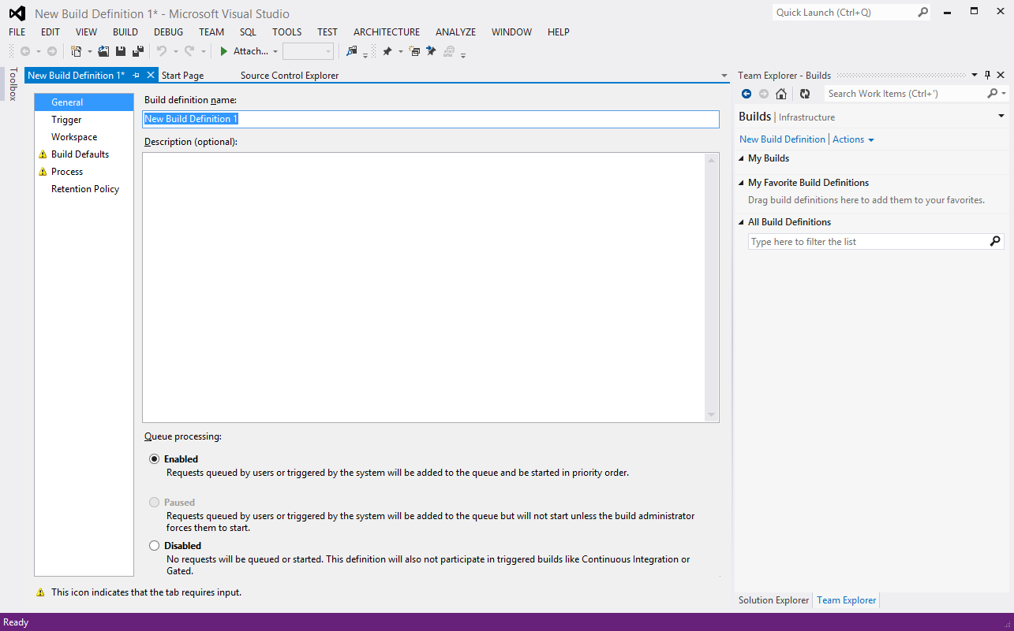
Automated Builds

Slide 29
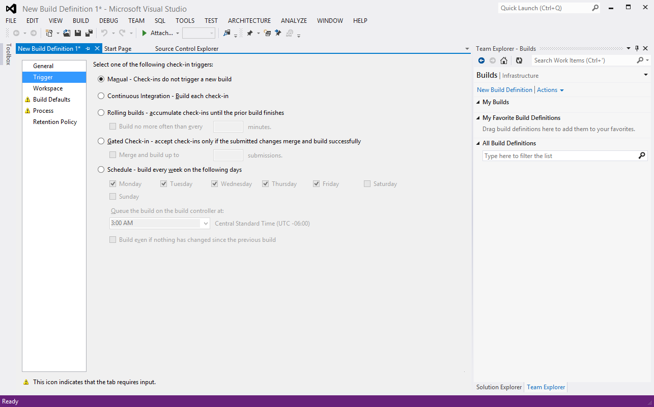
Automated Builds

Slide 30
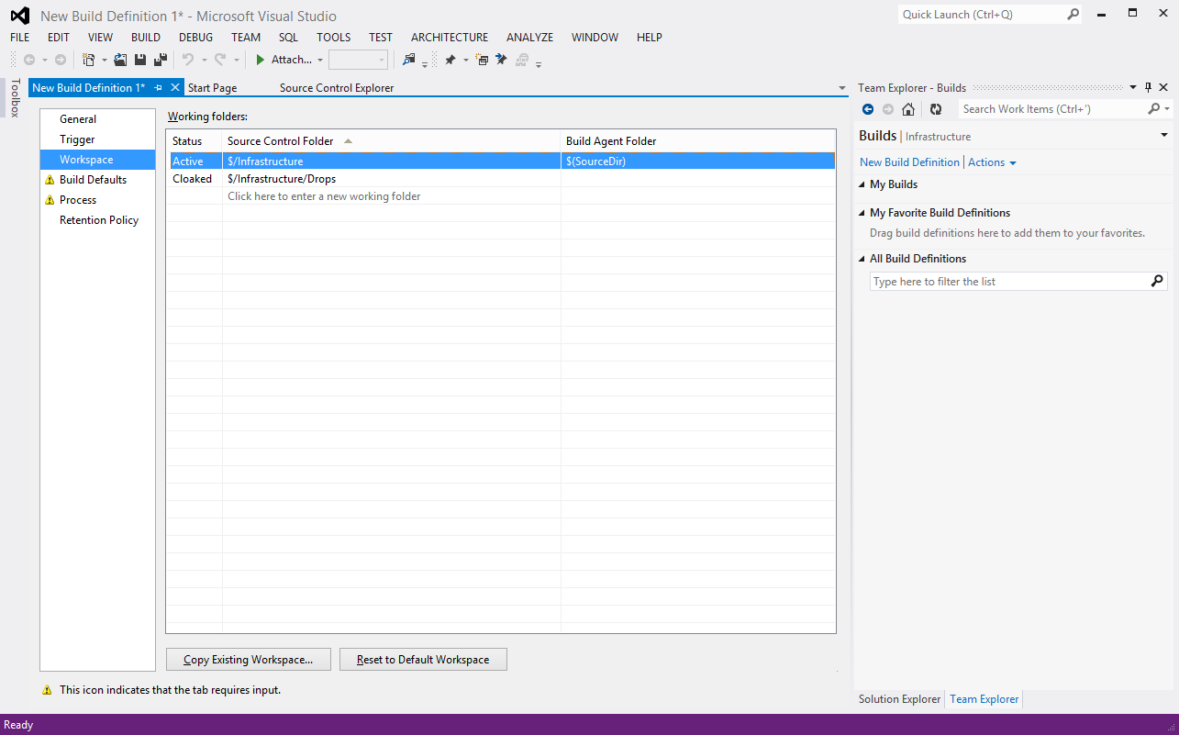
Automated Builds

Slide 31
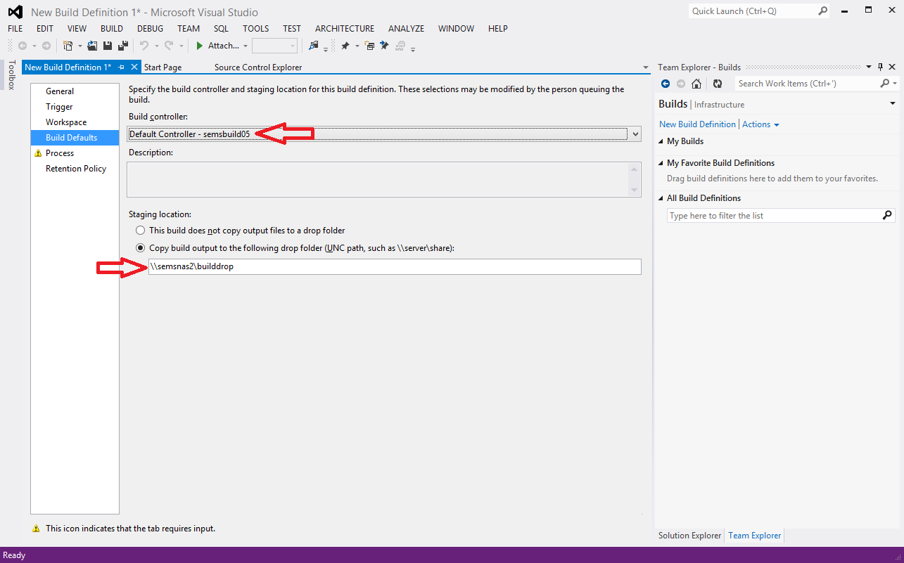
Automated Builds

Slide 32
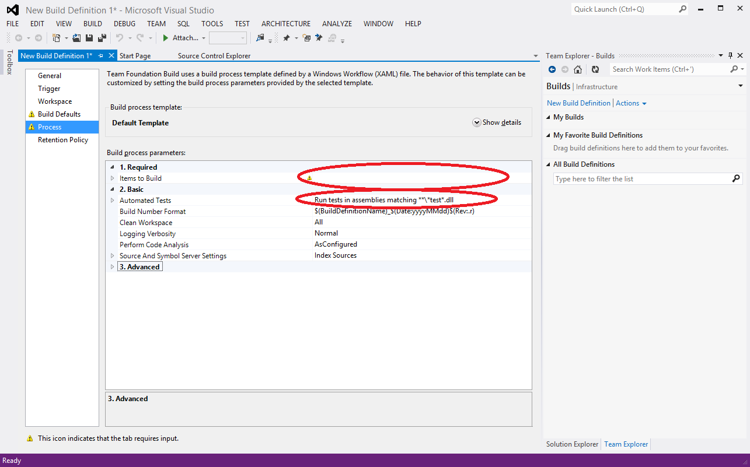
Automated Builds

Slide 33
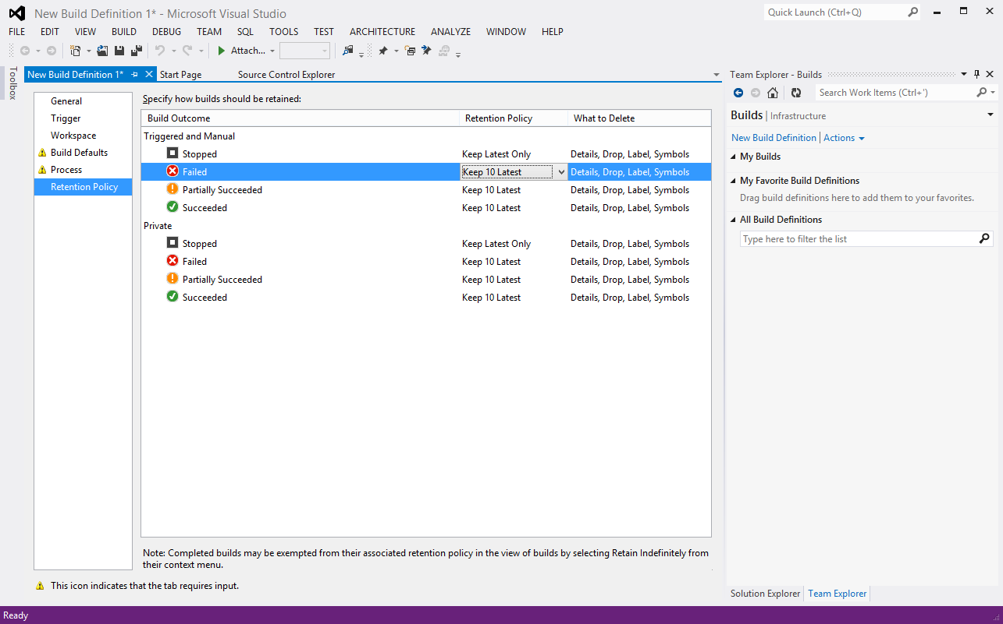
Automated Builds

Slide 34
End of Session 3 - Thank you!

Slide 35
Resources
SEMS Team Foundation Server: http://semstfs.usac.mmm.com/
Team Foundation Server - Using Version Control: http://msdn.microsoft.com/en-us/library/ms181368(VS.100).aspx
Application Lifecycle Management with TFS:
http://msdn.microsoft.com/en-us/library/vstudio/fda2bad5.aspx
Michael E. O’Brien meobrien@mmm.com (651) 733-4652

